Slide 1


Is the New York Times Accurately Depicting Business News?
Vincent Paparang

Slide 2




Has the New York Times Served its Purpose?
Background
Goals
150
Articles/day
Trusted
Accurate
9m+
Digital & Print Subscribers
Recent

Slide 3




Data Sourcing and Processing
1000 Article Titles
Took the titles of the past 1000 business articles released
S&P500 Daily Change
Used as a measure of financial performance to reference

Slide 4


Sentiment Analysis
Loughran-Mcdonald Polarity Library
Times Series plot validating on the S&P500

Slide 5
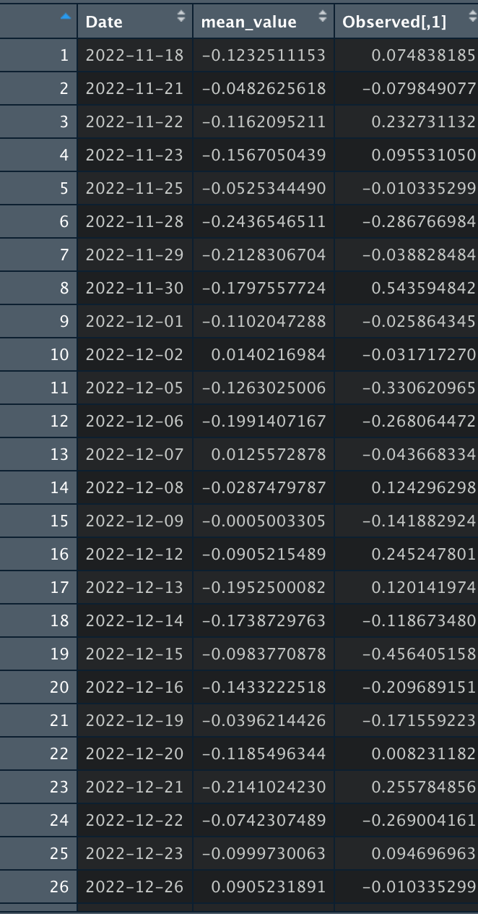
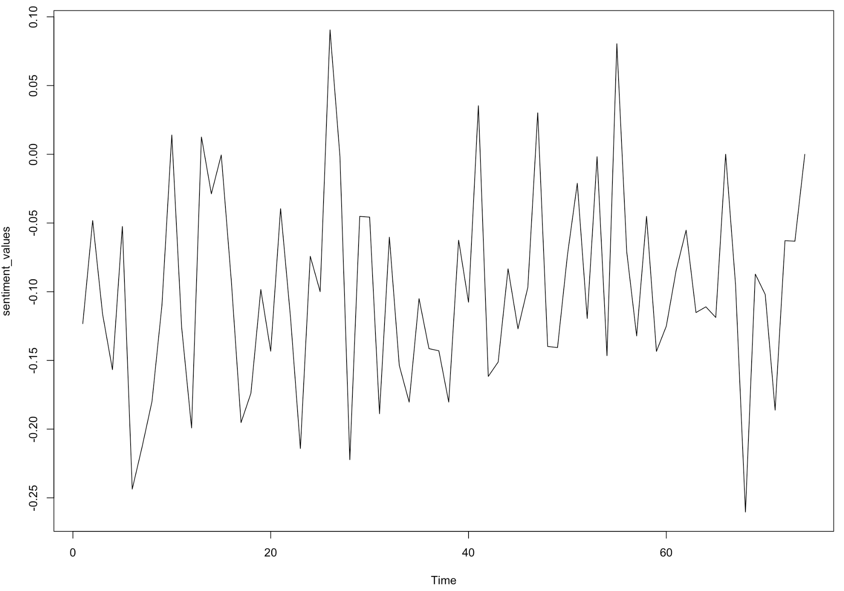
Sentiment Analysis

Slide 6
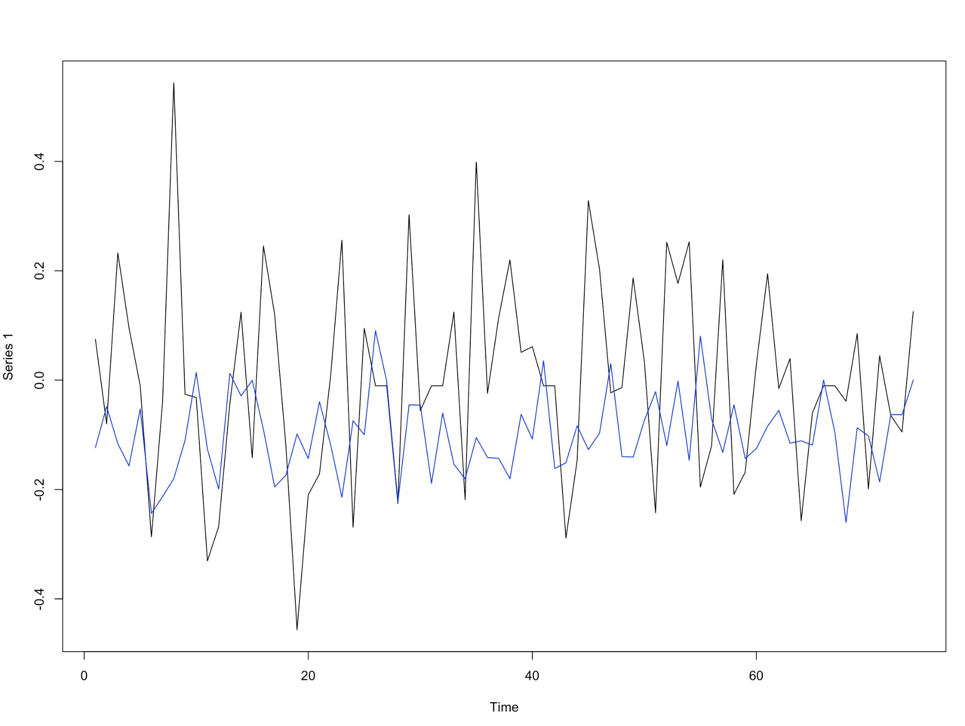
Results
Summary Statistics
0.225
RMSE
0.176
MAE
259.201
MAPE

Slide 7
Thank You!

